Slide 1
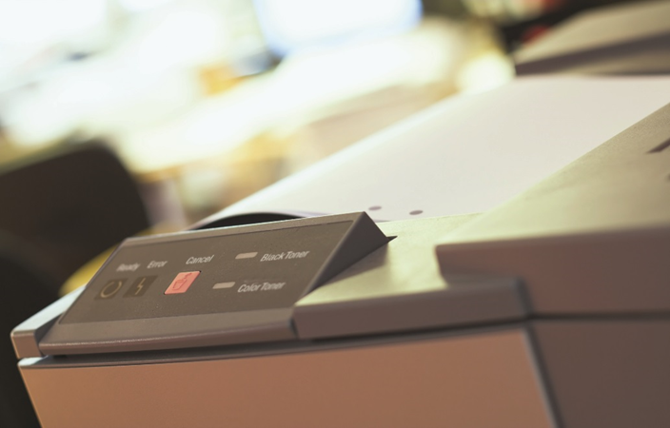
IT Essentials (CompTIA A+) Ch. 27
Printers and Multifunction Devices

Slide 2
Overview
In this chapter, you will learn how to:
Describe current printer and multifunction device technologies
Explain the laser printing process
Install and configure a printer or multifunction device
Recognize and fix basic printer and multifunction device problems
Notes:
Instructor Tip
When gaining attention and establishing common ground, ask questions of the class such as, “How many here do not have a printer?” or “How many of you have had printer problems?”
For a positive statement, tell the class, “In this lesson, we will learn about the various types of printers and how to install and troubleshoot them.”

Slide 3
Introduction
Back in the 1990s, the multifunction device (MFD), also known as the multifunction printer (MFP), tried to consolidate multiple functions (often printing and scanning) into a single device.

Slide 4
Printers
Impact printers
Leave an image on the paper by physically striking an inked ribbon against the surface of the paper.
Dot-matrix printers still soldier on in many offices.
An array of pins known as printwires strike an inked printer ribbon and produce images.
The case that holds the print wires is called the printhead.
The 9-pin printers are called draft quality; the 24-pin printers are known as letter quality or near-letter quality (NLQ).

Slide 5
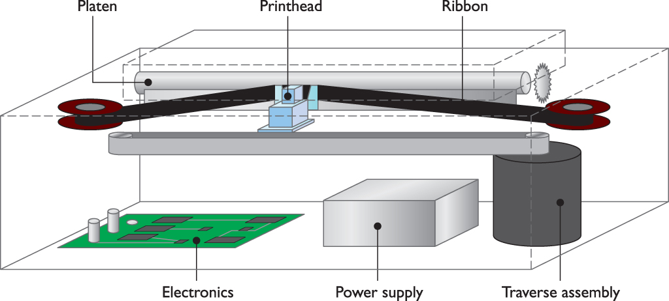
Printers
Figure 27.3 Inside a dot-matrix printer

Slide 6
Printers
An inkjet printer uses a printhead connected to a carriage that contains the ink.
A belt and motor move the carriage back and forth so the ink can cover the whole page.
Ink is ejected through tiny tubes.
Ink is heated by tiny resistors or electroconductive plates at the end of each tube.
The resistors or plates boil the ink, which creates a tiny air bubble that ejects a droplet of ink onto the paper.
Some inkjets use mechanical methods to eject ink.

Slide 7
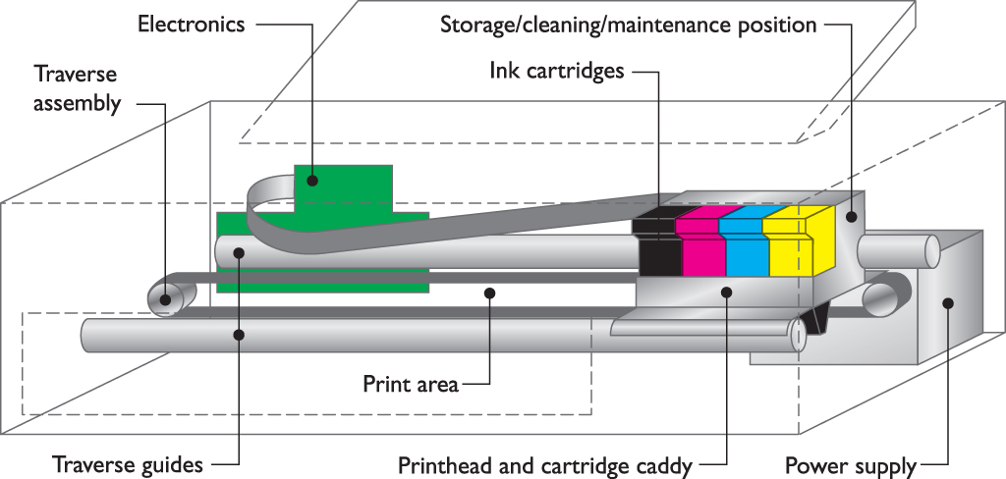
Printers
Figure 27.5 Inside an inkjet printer

Slide 8
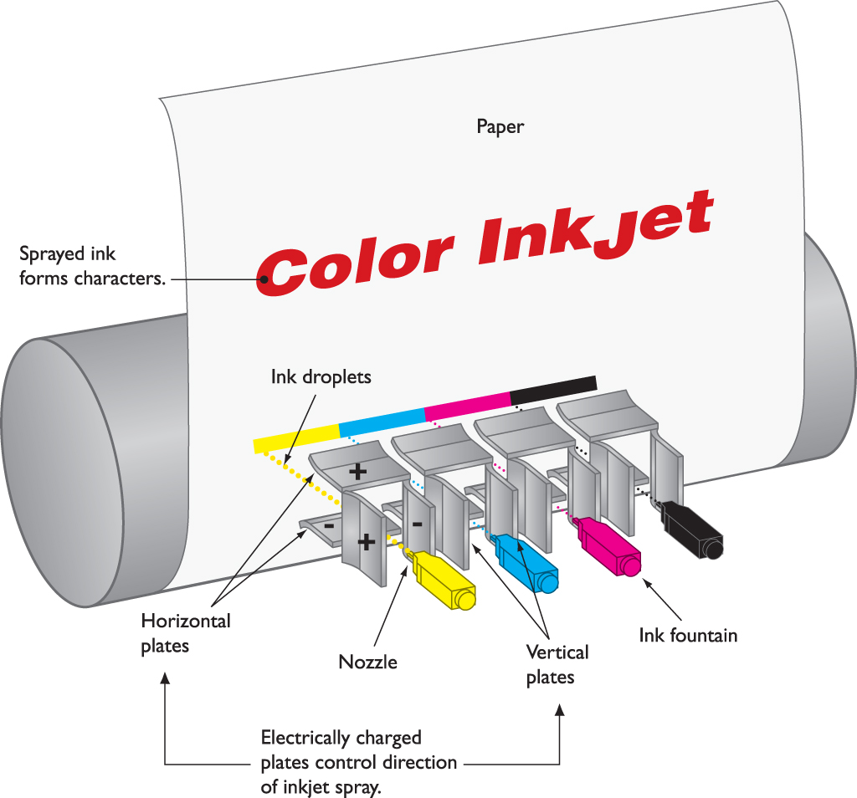
Printers
Figure 27.6 Detail of the inkjet printhead

Slide 9
Printers
The ink is stored in special small containers called ink cartridges.
Older inkjets had two ink cartridges, black, and color.
Today’s inkjet printers have six, eight, or more color cartridges.
Print resolution is the density of the ink.
Measured in dots per inch (dpi)
Print speed is measured in pages per minute (ppm).
Notes:
Cost of ink is between $4000 - $8000 per gallon!

Slide 10
Printers
Dye-sublimation printers (thermal dye transfer printers)
Used for photo printing, high-end desktop publishing, medical and scientific imaging, and other applications
Produce fine detail and rich color
Utilize the CMYK (cyan, magenta, yellow black) printing method
Require one pass per page for each color
Create continuous-tone images
Produce high-quality output that rivals professional photo-lab processing

Slide 11
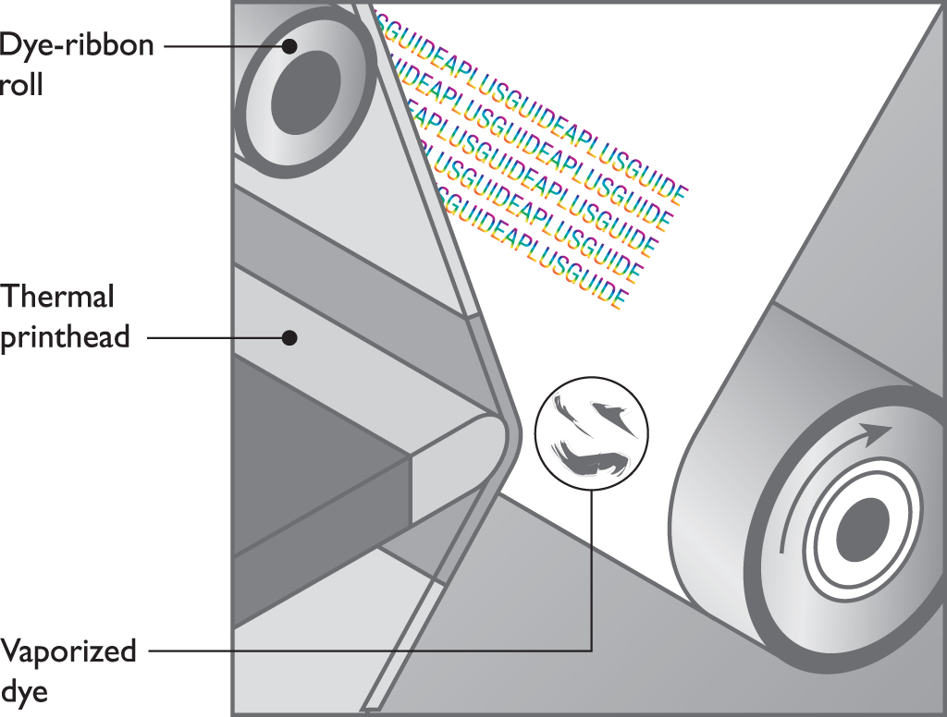
Printers
Figure 27.8 The dye-sublimation printing process

Slide 12
Printers
Thermal printers
A heated printhead creates a high-quality image on special or plain paper.
Direct thermal printer
Burns dots into the surface of special heat-sensitive thermal paper
Thermal wax transfer printer
Works similarly to dye-sublimation printers
Uses film coated with colored wax that gets melted onto page
Does not require special paper
Uses color dithering

Slide 13
Laser Printers
Laser printers use a mechanism called electro-photographic imaging.
Rely on the photoconductive properties of certain organic compounds.
Photoconductive means that particles of these compounds, when exposed to light (that’s the “photo” part), will conduct electricity.
The CompTIA A+ certification exams take a keen interest in the particulars of the laser printing process—or specifically, the imaging process.
Notes:
Tech Tip
Hidden Costs
Some printers use consumables at a much faster rate than others, prompting the industry to rank printers in terms of their cost per page. An inexpensive printer (laser or inkjet) costs around 4 cents per page, while an expensive printer can cost more than 20 cents per page—a huge difference if you do any volume of printing. This hidden cost is particularly pernicious in the sub-$100 inkjet printers on the market. Their low prices often entice buyers, who then discover that the cost of consumables is outrageous—these days, a single set of color and black inkjet cartridges can cost as much as the printer itself, if not more!

Slide 14
Laser Printers
Toner cartridge
Supplies the toner
The imaging drum (also called the photosensitive drum)
An aluminum cylinder coated with particles of photosensitive compounds
Erase lamp
Exposes the entire surface of the photosensitive drum to light, draining any electrical charge

Slide 15
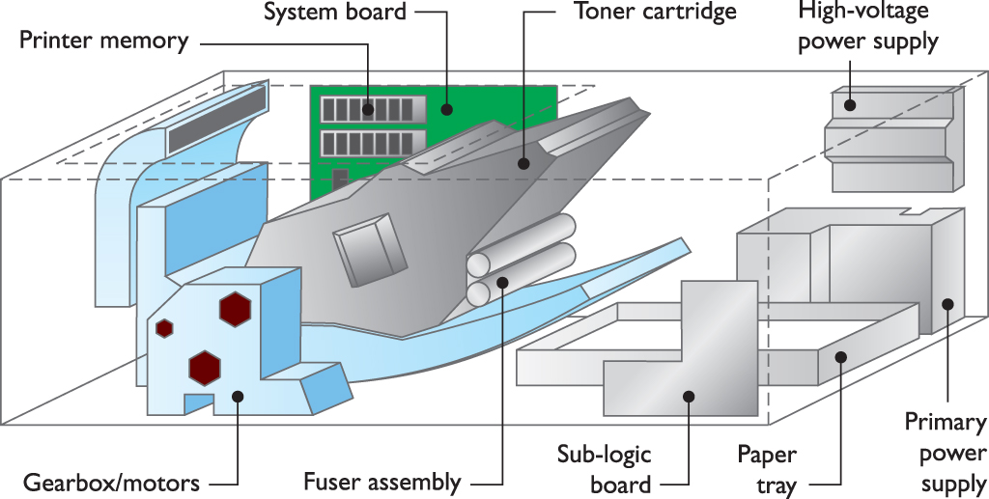
Laser Printers
Figure 27.10 Components inside a laser printer

Slide 16
Laser Printers
The primary corona wire (or primary charge roller, in newer laser printers):
Enables voltage to pass to the drum and charge the photosensitive particles on its surface
Creates a uniform negative charge (~600 to ~1000 volts)
Laser
Acts as the writing mechanism of the printer
Discharges areas on drum to negative ~100 volts
Notes:
Called a charge roller in newer laser printers

Slide 17
Laser Printers
Toner is fine powder made up of plastic particles bonded to iron particles.
Charged by toner cylinder with a negative charge of between ~200 and ~500 volts
Attracted to the parts of the drum struck by the laser
Notes:
Discussion Point
Toner
Toner is nasty! It is a very fine powder that seems to jump onto your new dress shirt from across the room! It gets into everything. Fortunately, it is relatively easy to clean up—just a damp cloth or paper towel will collect it. However, it is nearly impossible to get out of clothing. Also, many governments consider it a hazardous waste, not to be thrown in the trash. Many companies recycle toner. Please check with your local authorities for disposal methods.

Slide 18
Laser Printers
Transfer corona/transfer roller
Transfer corona, a thin wire, applied a positive charge to the paper, drawing the negatively charged toner particles to the paper.
Newer printers accomplish the same feat using a transfer roller that draws the toner onto the paper.
To prevent the paper from wrapping around the drum, a static charge eliminator removes the charge from the paper.
Notes:
In newer printers, a transfer roller draws the toner onto the paper.

Slide 19
Laser Printers
Fuser assembly
Attaches the toner permanently to the paper using a pressure roller and heated roller.
Power supplies
The corona in a laser printer requires extremely high voltage from the power supply.
A laser printer power supply is one of the most dangerous devices in computing!
Notes:
Safety Alert
Because of the high voltage present in a laser printer, you should unplug it even before changing toner cartridges.

Slide 20
Laser Printers
Turning gears
First, the paper must be grabbed by the pickup roller and passed over the separation pad.
Uses friction to separate a single sheet from any others that were picked up
More sophisticated laser printers enable duplex printing – print on both sides of the paper.
A dedicated duplexing assembly reverses the paper.
In most laser printers, the gear systems are packed together in discrete units generically called gear packs or gearboxes.

Slide 21
Laser Printers
System board
Contains the main processor, ROM, and RAM
Insufficient RAM can result in memory overflow error.
Ozone filter
Ozone (O₃) generated by coronas can damage printer components.
Filter needs to be replaced periodically.
Sensors and switches
Detect paper jams, empty paper trays, low toner levels, and so on

Slide 22
Solid Ink Printers
Solid ink printers use solid sticks of non-toxic “ink”.
Ink is melted and absorbed into the paper fibers.
Printing only needs a single pass.
Notes:
Solid ink offers significant advantages over color laser in the proper applications:
Serious heavy monthly duty cycle: 185,000 pages average
Up to 30 ppm in color
Laser printers use 30X more waste over 100,000 prints
1/3 the moving parts of a laser printer
One downside is the life expectancy of the printouts:
Two years in office lighting
Two months in sunlight

Slide 23
Virtual Printers
A virtual printer is a program that converts the output from your computer into a specific format and saves the result to a portable file that looks like the printed page would have.
Virtual printing options include:
Print to PDF – one of the most popular virtual printing options
Print to XPS
Print to image

Slide 24
Virtual Printers
Cloud and remote printing
A variety of applications, such as Google Cloud Print, will install a virtual printer on your system.
The virtual printer wraps up your document and sends it out over the Internet or other network to a cloud server.
Eventually, the document is routed to a real printer for printing.

Slide 25
Printer Languages
American Standard Code for Information Interchange (ASCII)
A standard set of basic alphanumeric characters, a few symbols, and a variety of control codes for transferring data and controlling printers
Notes:
PDL makes PDF files.

Slide 26
Printer Languages
The PostScript page description language (PDL) developed by Adobe
PostScript is a device-independent printer language capable of high-resolutions and scalable fonts.
Printers print faster because most of the image processing is done by the printer and not the PC.
PostScript defines page as single raster image.
PostScript files are very portable.

Slide 27
Printer Languages
Hewlett Packard developed the printer control language (PCL).
An expanded set of printer commands
Dependent on the printer hardware
Does not support advanced graphical functions
Windows uses the graphical device interface (GDI).
The operating system handles print functions.
If the printer has a capable raster image processor and enough RAM, you don’t need to worry about the printer language.

Slide 28
Printer Languages
Windows Vista introduced the XML Paper Specification (XPS) print path.
XPS provides enhanced color management and print layout fidelity.
The XPS print path requires a driver that supports XPS.

Slide 29
Scanners
All flatbed scanners, the most common variety of scanner, work the same way.
You place a photo or other object face down on the glass (called the platen), close the lid, and then use software to initiate the scan.
A scanner uses TWAIN drivers – TWAIN stands for Technology Without an Interesting Name.

Slide 30
How to Choose a Scanner
Configurable variables
Scanners convert the scanned image into a grid of pixels (often referred to as dots).
Manufacturers cite two sets of numbers for a scanner’s resolution:
Resolution achieved mechanically—called the optical resolution.
Enhanced resolution achieved with assistance from some onboard software.
The color depth of a scan defines the number of bits of information the scanner can use to describe each individual pixel.

Slide 31
How to Choose a Scanner
Scanners differ a lot in grayscale depth.
A number that defines how many shades of gray the scanner can save per pixel
Scanning speed
Scanners have a maximum scanning speed defined by the manufacturer.
Time required to complete a scan is also affected by the parameters you set.
The time increases as you increase the amount of detail captured.

Slide 32
Scanning Tips
As a general rule, you should obtain the highest quality scan you can manage, and then play with the size and image quality when it’s time to print it or share it over the Web.

Slide 33
Copy and Fax Components
The scanning and printing capabilities of a multifunction device enable manufacturers to add copy-machine features easily.
To copy a document or photo, you essentially scan a document or photo and then print it, but all with a single press of the Copy button.
Faxing generally requires separate functions in the machine, such as a document feed and a connection to a traditional, analog phone line.

Slide 34
Connectivity
New printers and multifunction devices
Use USB connections that you can plug into any USB port on your computer
Network connections
The typical network printer comes with its own built-in Wi-Fi adapter.
Enables wireless printing over infrastructure or ad hoc network connections
If a printer does not have built-in networking, you can purchase a print server, a standalone network device, to connect your printer to the network.

Slide 35
The Laser Printing Process
The imaging process with a laser printer breaks down into seven steps:
Processing People
Charging Charge
Exposing Extra
Developing During
Transferring The
Fusing Fuser
Cleaning Cleaning

Slide 36
Processing
The print spooler enables you to queue up multiple print jobs handled sequentially.
Once the printer receives some or all of a print job, the hardware of the printer takes over and processes the image.
Laser printers generate a raster image (pattern of dots) of the page.
The raster image processor (RIP) chip translates the raster image into commands for the laser printer.

Slide 37
Processing
RIP needs RAM in order to store the data it must process.
A memory overflow error indicates insufficient RAM.
HP LaserJet 21 error means the data is too complex.

Slide 38
Processing
Resolution
Resolution is expressed in dots per inch (dpi).
The first number is the horizontal resolution—how fine a focus can be achieved by the laser.
The second number is the vertical resolution—the smallest increment by which the drum can be turned.
Resolution enhancement technology (RET)
RET enables the printer to insert smaller dots among characters to smooth out jagged curves.
Disabling RET helps reduce MEM OVERFLOW errors.

Slide 39

Processing
Figure 27.18 RET fills in gaps with smaller dots to smooth out jagged characters.

Slide 40
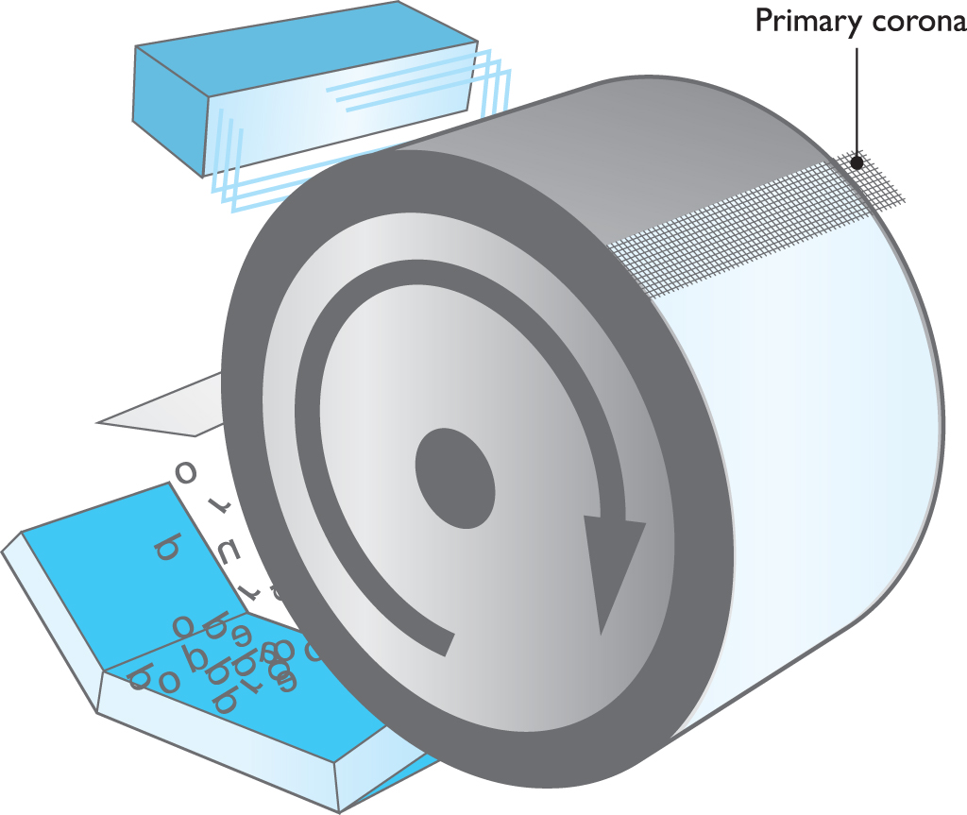
Charging
A negative charge (between ~600 and ~1000 volts) is applied to the entire drum surface.
Charged by the primary corona wire.
Figure 27.19 Charging the drum with a uniform negative charge

Slide 41
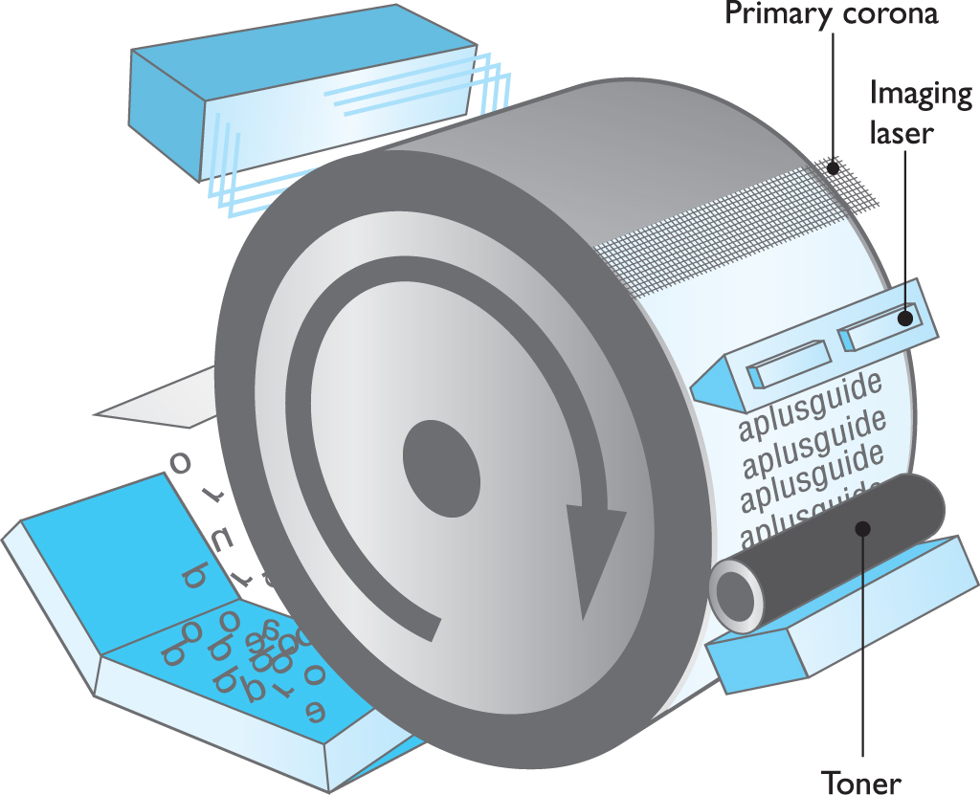
Exposing
A laser writes and develops an image on the surface of the drum.
Every particle hit by the laser releases most of its negative charge into the drum.
Figure 27.20 Writing the image and applying the toner

Slide 42
Developing
Those particles with a lesser negative charge are positively charged relative to the toner particles and attract them, creating a developed image.

Slide 43
Transferring
The transfer corona or transfer roller gives the paper a positive charge.
The negatively charged toner particles leap from the drum to the paper.
At this point, the particles are merely resting on the paper and must still be permanently fused to the paper.
Notes:
Discussion Point
Charges
Remember the phrase from high-school science class, “opposites attract”? That is the underlying principle behind laser printers. The toner jumps around from one place to another based on the positive or negative charges it is following. The negatively charged toner seeks out and jumps to the positively charged paper.

Slide 44
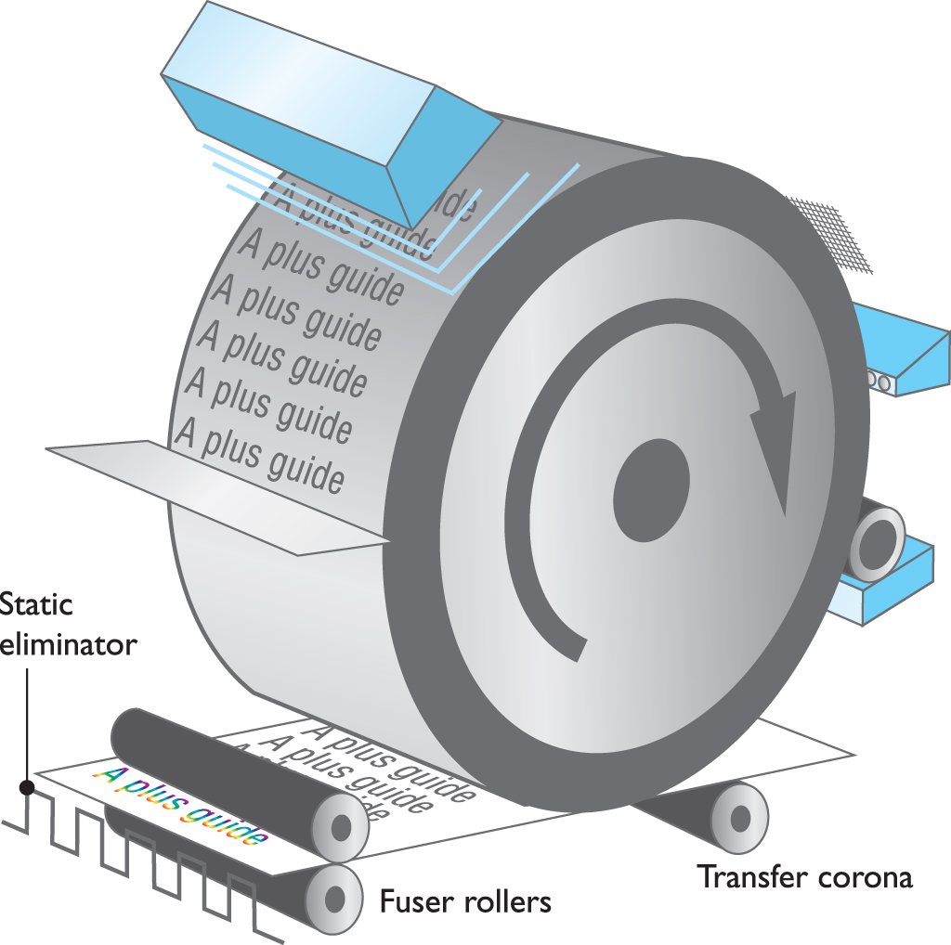
Transferring
Figure 27.21 Transferring the image to the paper and fusing the final image

Slide 45
Fusing
Image fused to the paper
The heat roller, made of a nonstick material, and the pressure roller fuse the image onto the paper.
Toner particles melt into the page.
Static charge eliminator removes the charge from the paper, preventing the paper from sticking to the drum.
Notes:
The heated roller produces enough heat to melt some types of plastic media, particularly overhead transparency materials. This could damage your laser printer (and void your warranty), so make sure you’re printing on transparencies designed for laser printers!

Slide 46
Cleaning
Printing process ends by physically and electrically cleaning the photosensitive drum.
Physically by scraping the surface of the drum with a rubber cleaning blade
Electrically with an erase lamp to completely discharge any particles

Slide 47
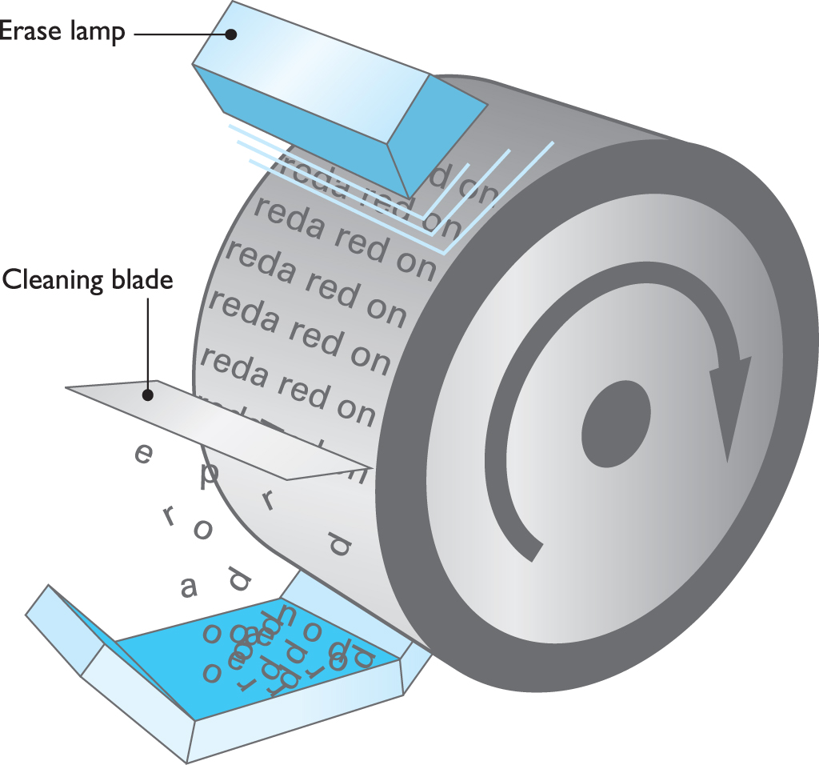
Cleaning
Figure 27.22 Cleaning and erasing the drum

Slide 48
Installing a Multifunction Device
Most multifunction devices today connect via USB and wirelessly, so you need to consider connectivity.
You need to install drivers for each of the various functions of the multifunction device.
A multifunction device is a very complex machine that can break in interesting ways.

Slide 49
Setting Up Printers in Windows
To Windows, a printer is not a physical device; it is a program that controls one or more physical printers.
The physical printer is called a print device.
Printer drivers and a spooler are still present, but in Windows, they are integrated into the printer itself.

Slide 50
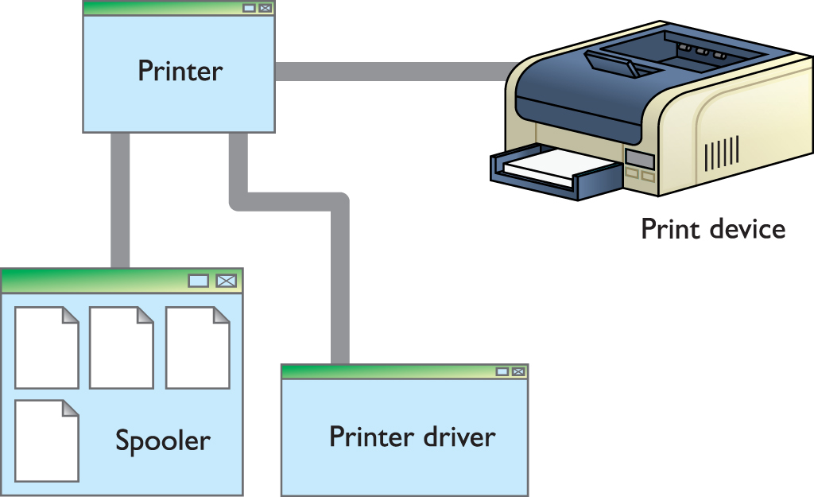
Setting Up Printers in Windows
Figure 27.23 Printer driver and spooler in Windows

Slide 51
Setting Up Printers in Windows
Most printers are plug and play.
Plug the printer in and load the driver if needed.
If the system does not detect the printer in Vista, open the Control Panel and find the Printer menu item .
With Windows 7 and newer, the applet has been renamed Devices and Printers.
Windows has two printer installation scenarios.
A printer connected directly to a computer (your local system or another one on a network)
A stand- alone printer directly connected to a switch or router
Notes:
With USB printers (and infrared printers, for that matter), Windows won’t even wait for you to do anything—once you connect a printer (or point the IR beam at a compatible PC), Windows immediately detects and installs the printer.

Slide 52
Setting Up Printers in Windows
Installing a local printer
This option is most commonly used to install standalone network printers using an IP address.
Manually select the proper driver.
You’ll be asked if the new local printer should be the default printer and whether you want to share it with other computers on the network.

Slide 53
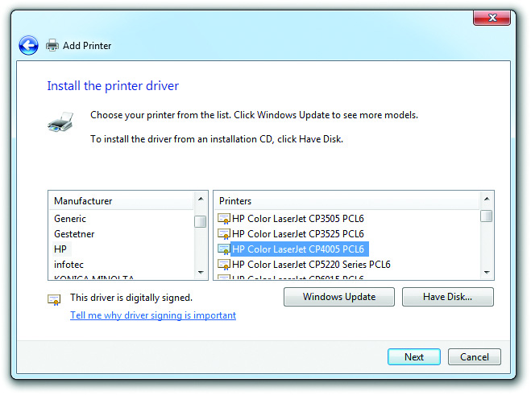
Setting Up Printers in Windows
Figure 27.24 Selecting drivers

Slide 54
Setting Up Printers in Windows
Installing a network printer
When you try to install a network printer, the Add Printer Wizard will scan for any available printers on your local network.
If Windows fails to find your printer, you’ll need to configure the network printer manually.
Remember that Windows doesn’t always see your network’s printers exactly how they are physically arranged.

Slide 55
Setting Up Printers in Windows
In addition to the regular driver installation outlined previously, some installations use printer emulation.
Printer emulation means using a substitute printer driver for a printer, as opposed to using one made exclusively for that printer.
Some printers may require you to set them into an emulation mode to handle a driver other than their native one.

Slide 56
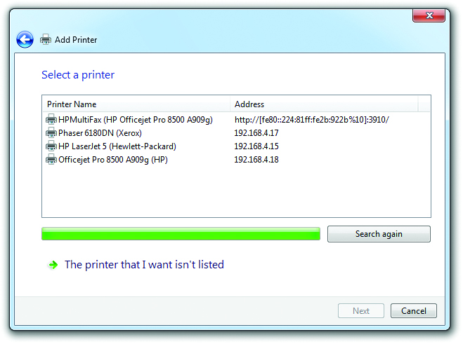
Setting Up Printers in Windows
Figure 27.25 List of available shared printers on a network

Slide 57
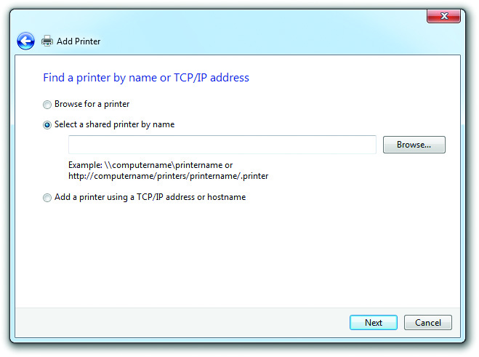
Setting Up Printers in Windows
Figure 27.26 Options for finding network printers

Slide 58
Configuring Print Settings
Layout
Duplex – specify whether and how to use each side of a printed page.
Orientation – choose landscape or portrait mode.
Multiple page – print multiple document pages on each physical page.
Scaling – fit a large document to a single page, or scale a small document up to the size of a full page.
Reverse or invert – print the mirror image of your document.

Slide 59
Configuring Print Settings
Paper
Set the paper size to one of several common paper sizes, or define a custom one.
Specify the paper type.
May involve setting thickness, coating, and special formats such as envelopes and labels.
A paper source setting lets you select any available paper trays, and possibly manual feed, in which case the printer will wait for you to feed it each sheet individually.

Slide 60
Configuring Print Settings
Quality
Resolution specifies at what DPI the document should be printed.
Some printers let you choose some mode or quality presets that optimize printing for graphics or text, or choose to manually configure your own advanced settings.
Some printers have settings that reduce ink or toner used, for economic and environmental reasons.

Slide 61
Configuring Print Settings
Other common settings
Apply a watermark – choose from presets or define your own.
A watermark is a lightly printed mark across every page.
Header/footer – add information about when a document was printed and who printed it.
Collate – specify the order in which multiple copies of a multi-page document are printed.
If the option is unchecked and you print ten copies, each page will be printed ten times before the printer moves on.

Slide 62
Optimizing Print Performance
Calibration uses hardware to generate an International Color Consortium (ICC) color profile.
ICC is a file that defines the color characteristics of a hardware device.
When your printer and monitor have been properly calibrated and the profiles installed, your prints and monitor display should match.
Windows includes Windows Color System (WCS) to help build color profiles for use across devices.
Notes:
To change the profile, check the Color Management tab in Printer Properties.

Slide 63
Managing Shared/Public/ Networked Devices
Network security
Wired or wireless network printers and multifunction devices are vulnerable to:
Attacks over the LAN
Attacks from the Internet
Security is often overlooked on these devices.
These devices are also common starting points for an attack on the broader network.

Slide 64
Managing Shared/Public/ Networked Devices
Data privacy
Unfortunately, it’s common for modern devices to contain a hard drive or other storage media used to cache copies of documents the device prints, scans, copies, or faxes.
Enterprise models often allow for user authentication on the device.
Limit use to authenticated users
Restrict features each user can access to only what each one needs

Slide 65
Troubleshooting General Issues
Tools of the trade
Multimeter
Cleaning solutions such as denatured alcohol
Extension magnet for retrieving loose screws
Optical disc or USB drive with test patterns
Phillips-head and flat-head screwdrivers
Notes:
Tech Tip
Readme Files
You’ve seen how to get your system to recognize a printer, but what do you do when you get a brand-new printer? Like most peripherals, you’ll have an installation CD that contains various useful files. One of the most important, but least used, tools on this CD is the Readme file. This file, generally in TXT format, contains the absolute latest information on any idiosyncrasies, problems, or incompatibilities related to your printer or printer driver. Usually, you can find it in the root folder of the installation CD, although many printer drivers install the Readme file on your hard drive, so you can access it from the Start menu. The rule here is read first to avoid a headache later!

Slide 66
Print Job Never Prints
Is the printer on? Connected?
Check all cables, ports, and power involved.
You attempt to use a printer shared by another computer, and Windows pops up with an “Access Denied” error.
You might not have permission to use the printer.
Check the spooler status in these ways:
Double-click the printer’s icon in the appropriate printer Control Panel applet.
Double-click the tiny printer icon in the notification area if it’s present.

Slide 67
Print Job Never Prints
Print spoolers can easily overflow or become corrupt due to a lack of disk space, too many print jobs, or one of a thousand other factors.
If you have problems with the print spooler, you can get around them by changing your print spool settings.
Use Print directly to the printer.
Try restarting the print spooler service.
Another possible cause for a stalled print job is that the printer is simply waiting for the correct paper!

Slide 68
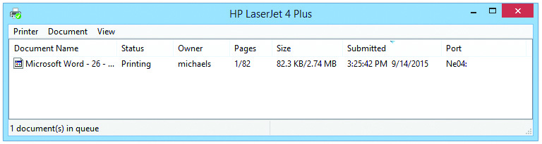
Print Job Never Prints
Figure 27.28 Print spooler

Slide 69
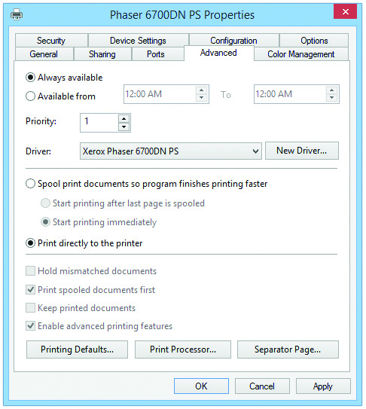
Print Job Never Prints
Figure 27.29 Print spool settings

Slide 70
Strange Sizes
Indication of user mistake in setting up the print job
Check the Page Setup interface to verify that the page is set up properly.
Recheck the printer drivers.
Uninstall and reinstall if necessary.

Slide 71
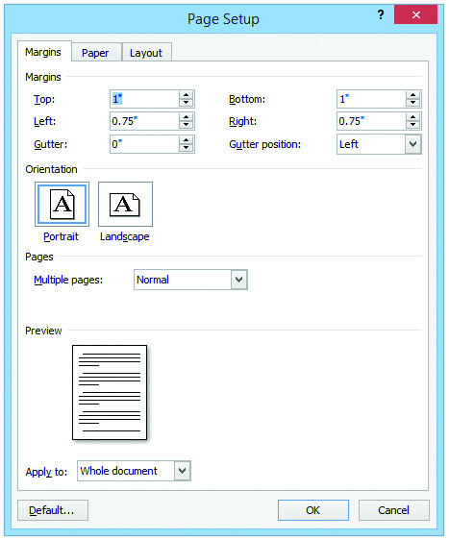
Strange Sizes
Figure 27.30 Page Setup options for Microsoft Word

Slide 72
Misaligned or Garbage Prints
If the printer driver is corrupted or incorrect driver, reinstall the driver.
You may have asked the printer to do something it can’t do, such as printing PostScript with a PCL driver.

Slide 73
Dealing With Consumables
All printers tend to generate a lot of trash in the form of consumables.
Many laws regulate the proper disposal of most printer components.
Check with the local sanitation department or disposal services company before throwing away any component.
Never throw away toner cartridges—certain companies will pay for used cartridges!

Slide 74
Crashes on Power-Up
Both laser printers and computers require more power during their initial power-up (the POST on a computer and the warm-up on a laser printer) than once they are running.
Turn on the laser printer first and allow it to finish its warm-up before turning on the computer.
This avoids having two devices drawing their peak loads simultaneously.

Slide 75
Display Screen Malfunction
Modern printers’ and multifunction devices’ small menu display screens can encounter issues.
Freezing, not coming on at all, displaying a single color, or artifacts such as lines showing on the display
Unfortunately, there’s not a lot you can do about these problems.

Slide 76
Troubleshooting Impact Printers
Dot-matrix printers require regular maintenance.
The printhead and the platen should be cleaned with denatured alcohol.
This prevents problems such as white bars on text, dots and smudges on paper, and so on.
Gears and pulleys should be lubricated according to the manufacturer’s specifications.

Slide 77
Troubleshooting Impact Printers
Bad-looking text
Problem may be due to a dirty or damaged printhead.
Clean with denatured alcohol or replace the printhead.
Bad-looking page
Clean the platen with denatured alcohol.
Adjust the platen.
Remember to replace the ribbon occasionally.

Slide 78
Troubleshooting Thermal Printers
Thermal printers are simple to troubleshoot and maintain.
There are only three things to worry about with direct thermal printers.
The heating element, the rollers, and the paper
With thermal wax printers, you also need to care for the wax ribbon.

Slide 79
Troubleshooting Thermal Printers
Steps to clean the heating element
Turn off the thermal printer and open it according to the manufacturer’s instructions.
Use denatured alcohol and a lint-free cloth to wipe off the heating element.
Use a little pressure to get it completely clean.

Slide 80
Troubleshooting Thermal Printers
Clean the rollers with a cloth or compressed air.
Keep them free of debris so they can properly grip the paper.
Replacing the paper is an easy procedure.
Slide off the old roll and replace it with a new one.
Feed the paper through the heating element; otherwise, you won’t print anything.

Slide 81
Troubleshooting Thermal Printers
Replacing the ribbon is similar to replacing the roll of paper.
Feed the ribbon past the heating element, or the printer won’t work properly.
Your printer’s manufacturer should include any special instructions for installing a new ribbon.

Slide 82
Troubleshooting Inkjet Printers
During initial inkjet printer setup, it normally instructs you to perform a routine (sometimes referred to as calibration) to align the printheads properly.
You print out a page and select from sets of numbered lines.
Inkjet cartridges are usually easy to replace.
The exact process can vary widely from printer to printer.
Notes:
Note: All inkjet inks are water-based, and water works better than alcohol to clean them up. Cleaning the heads on an inkjet printer is sometimes necessary, but I don’t recommend that you do it on a regular basis as preventive maintenance. The head-cleaning process uses up a lot of that very expensive inkjet ink—so do this only when a printing problem seems to indicate clogged or dirty print heads!

Slide 83
Troubleshooting Inkjet Printers
Inkjet problems
The inkjet’s printer head nozzles benefit from cleaning.
On older inkjets, press buttons on the printer to start a maintenance program.
On more modern inkjets, access the head-cleaning maintenance program from Windows.
Multi-sheet paper grab may be caused by humidity or an overheated printer.
Fan sheets of the paper stack before adding to the paper tray.
Check to see if excess ink overflow is a problem.

Slide 84
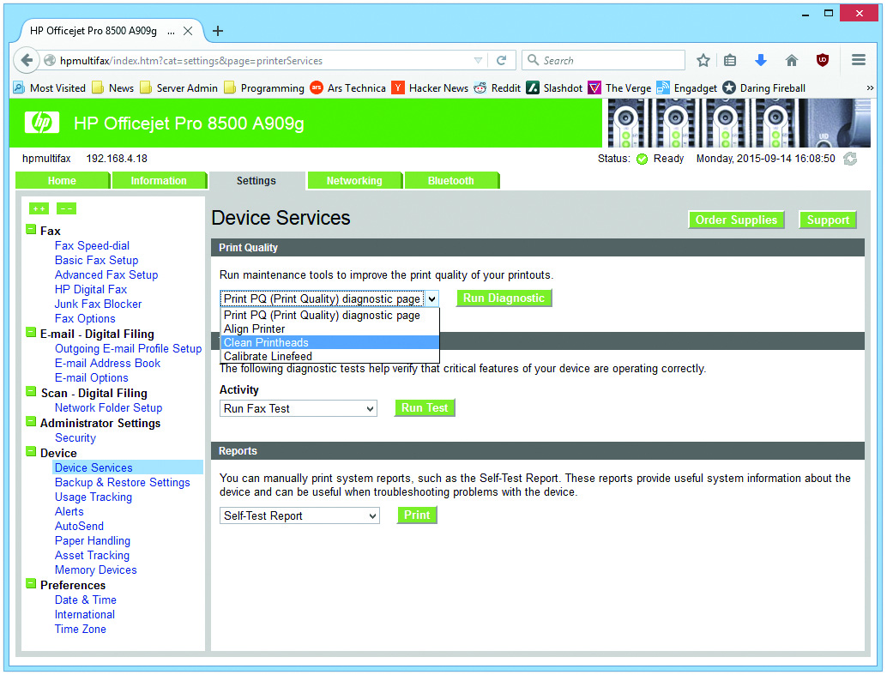
Troubleshooting Inkjet Printers
Figure 27.31 Inkjet printer maintenance screen

Slide 85
Laser Printer Maintenance
Keep the printer clean.
Excess toner and paper dust commonly cause the printer to get dirty.
Clean with a special low-static vacuum designed for electrical components (indoors) or a can of compressed air (outdoors!).
The rubber guide rollers pick up dirt and paper dust over time, which causes paper jams.
Notes:
Before you service a laser printer, always, ALWAYS turn it off and unplug it! Don’t expose yourself to the very dangerous high voltages found inside these machines.
The photosensitive drum, usually contained in the toner cartridge, can be wiped clean if it becomes dirty, but be very careful if you try this! If the drum becomes scratched, the scratch will appear on every page printed from that point forward. The only repair in the event of a scratch is to replace the toner cartridge.
Failure of the thermal fuse (used to keep the fuser from overheating) can necessitate replacing the fuser assembly. Some machines contain more than one thermal fuse. As always, follow the manufacturer’s recommendations.
Many manufacturers have kits that alert you with an alarm code to replace the fuser unit and key rollers and guides at predetermined page counts.
Always let the fuser assembly cool down before cleaning it—they operate at 200 to 300 degrees Fahrenheit!

Slide 86
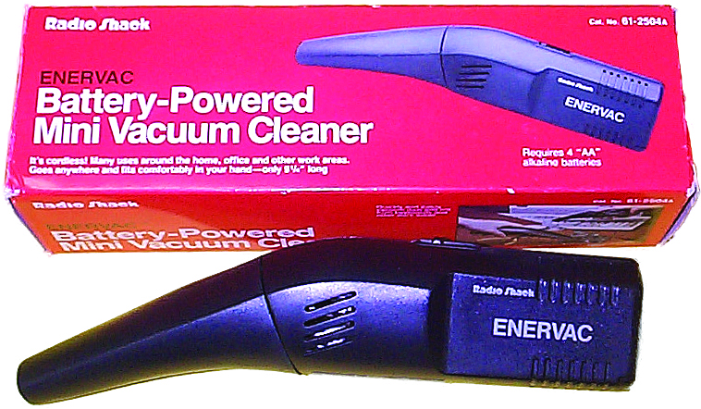
Laser Printer Maintenance
Figure 27.32 Low-static vacuum

Slide 87
Laser Printer Maintenance
Periodic maintenance
Follow manufacturer’s recommendations.
Most manufacturers sell maintenance kits for their printers.
These include sets of replacement parts, such as a fuser, as well as one or more rollers or pads.
After installing, reset the page count.
Clean or replace ozone filters regularly.
Check and clean fuser assembly and heat roller.
Notes:
Note: Failure of the thermal fuse (used to keep the fuser from overheating) can necessitate replacing the fuser assembly. Some machines contain more than one thermal fuse. As always, follow the manufacturer’s recommendations. Many manufacturers have kits that alert you with an alarm code to replace the fuser unit and key rollers and guides at predetermined page counts.

Slide 88
Laser Printer Problems
Print a diagnostic print page (or an engine test page) as a first-step in troubleshooting.
If blank pages are printed:
The printer may be out of toner.
Check the imaging drum to see if the image is on drum but not transferred to paper.
If image is seen on the drum, transfer corona or high-voltage power supply has failed.

Slide 89
Laser Printer Problems
Dirty or smudged printouts
Light dusting of toner on the paper (front or back) indicates a dirty printer.
Clean the printer.
Notes:
If the printout looks smudged, the fuser isn’t properly fusing the toner to the paper. Depending on the paper used, the fuser needs to reach a certain temperature to fuse the toner. If the toner won’t fuse to the paper, try using a lighter-weight paper. You might also need to replace the fuser.

Slide 90
Laser Printer Problems
Ghosting
Reasons ghost images sometimes appear at regular intervals on the printed page.
The imaging drum has not fully discharged and is picking up toner from a previous image.
A previous image has used up so much toner that either the supply of charged toner is insufficient or the toner has not been adequately charged.
This can also be caused by a worn-out cleaning blade that isn’t removing the toner from the drum.

Slide 91
Laser Printer Problems
Light ghosting vs. dark ghosting
Most common cause of light ghosting is “developer starvation.”
For dark ghosting, the proper solution is using less toner.

Slide 92
Laser Printer Problems
Ways to fix ghosting problems
Lower the resolution; use a different pattern.
Avoid 50 percent grayscale; and dot-on/dot-off patterns.
Change the layout so grayscale patterns do not follow black areas.
Make dark patterns lighter and vice versa.
Print in landscape.
Adjust print density and RET settings.
Print a completely blank page before the next page.

Slide 93
Laser Printer Problems
Vertical white lines
These are caused by a clogged toner.
Try shaking the toner cartridge or replacing it.
Blotchy print
This is due to an uneven dispersion of toner.
Try shaking the toner cartridge from side to side.
Make sure the printer is level.
Make sure the paper is not wet in spots.
Check the fusing rollers and photosensitive drum for foreign objects.

Slide 94
Laser Printer Problems
Spotty print
Try wiping off the fuser rollers.
Check the drum for damage.
Embossed effect
Correct for an embossed effect by:
Removing a foreign object on a roller
Replacing the toner cartridge if a foreign object is on the photosensitive drum
Adjusting the contrast control if it is set too high

Slide 95
Laser Printer Problems
Incomplete characters
These may occur on transparencies.
Try adjusting the print density.
Creased pages
Cotton bond paper is more susceptible.
Try using a different paper type.

Slide 96
Laser Printer Problems
Paper jams
Do not pull on the paper to remove it.
Pulling the paper can damage the printer.
Check manufacturer’s jam-removal procedure.
If there is no jammed paper, sensors may be bad.
Pulling multiple sheets
Try using a different ream of paper—if that works, the issue is humidity.
Check the separation pad—a small piece of rubber or cork that separates the sheets as they are pulled from the paper tray.

Slide 97
Laser Printer Problems
Warped, overprinted, or poorly formed characters
Avoid paper that is too rough or too smooth.
Don’t open paper ream until ready to load it.
Always fan paper before loading it in the printer.
Check the hardware.
Replace the toner cartridge; check the cabling; replace the data cable
Turn off advanced functions and high-speed settings.
May not be supported by your software configuration

Slide 98


Slide 99
Summary
Describe current printer and multifunction device technologies
Explain the laser printing process
Install and configure a printer or multifunction device
Recognize and fix basic printer and multifunction device problems
Notes:
99
Instructor Tip
When gaining attention and establishing common ground, ask questions of the class such as, “How many of you have ever had a computer infected by a virus or spyware?” or “How many of you have ever lost data?”
For a WIIFM statement, say to the class, “Joe’s at work, and Sally calls him up on the phone saying she’s from the IT department and needs to upgrade his computer with several key applications. Joe’s computer will be down for several hours. “Oh no,” he says, realizing he needs to get some work done and needs the computer. “Isn’t there another way?” Joe asks. Sally says, ‘Well, don’t tell anyone I’m doing this, but I can do it remotely while you’re still using the computer. The thing is, though, I’ll need your user name and password.” Does Joe give the password to Sally? This is a classic example of social engineering; Sally doesn’t really work in the IT department but instead is simply randomly calling people trying to get their password. We’ll learn about this and other security threats in this chapter.”

Slide 100


